Slide 1

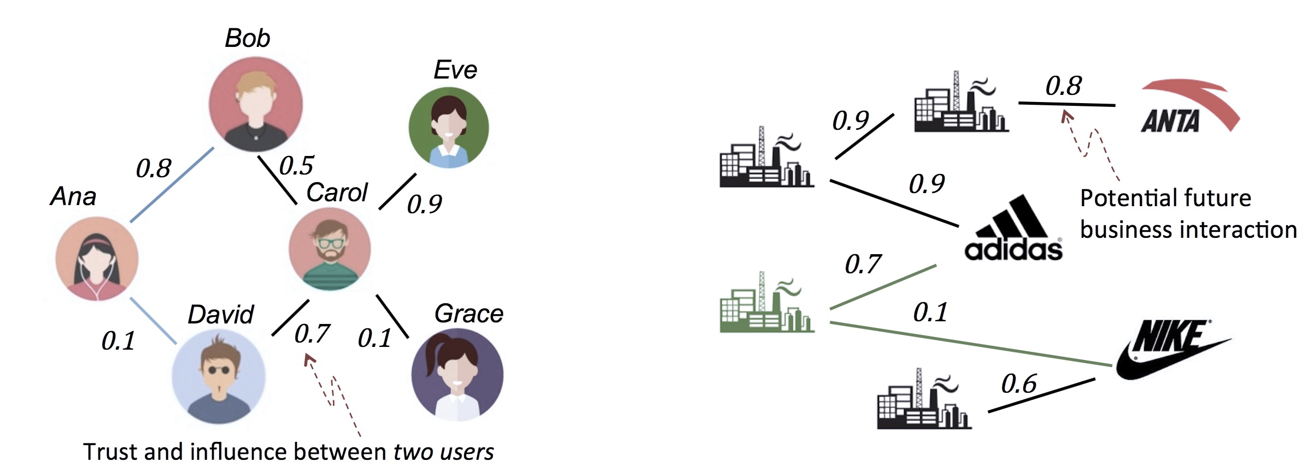
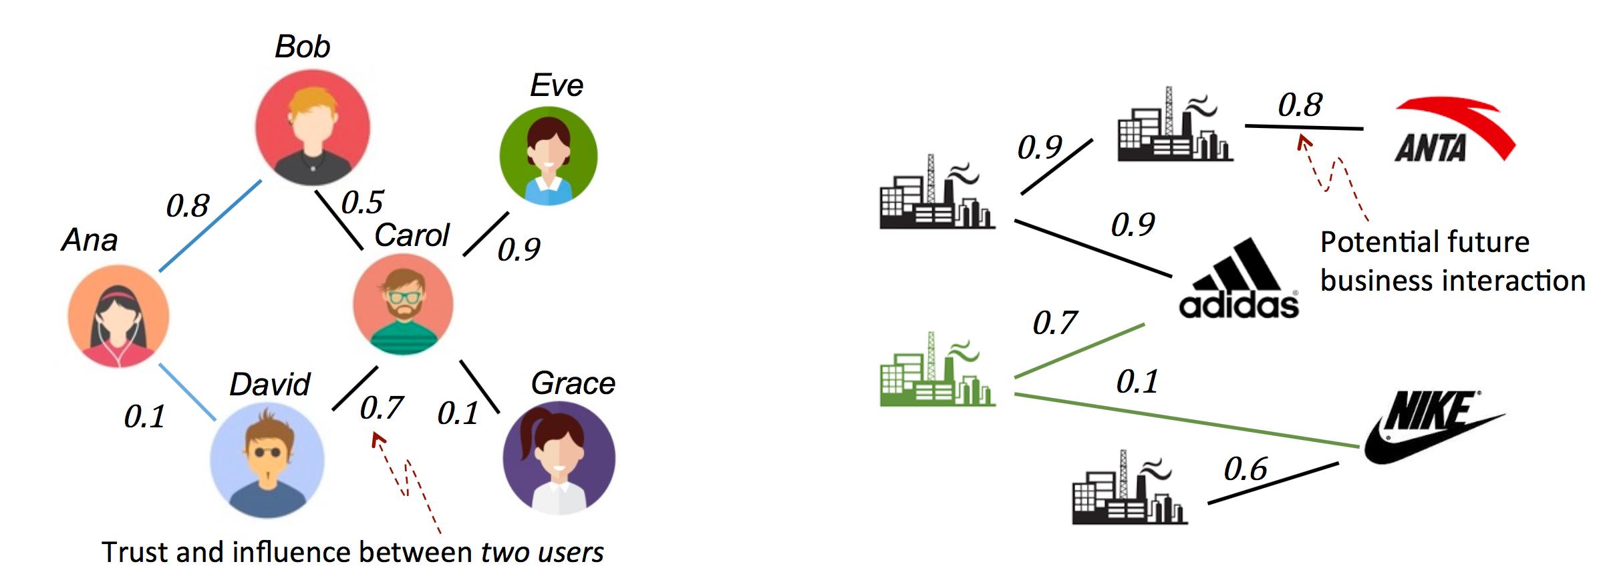

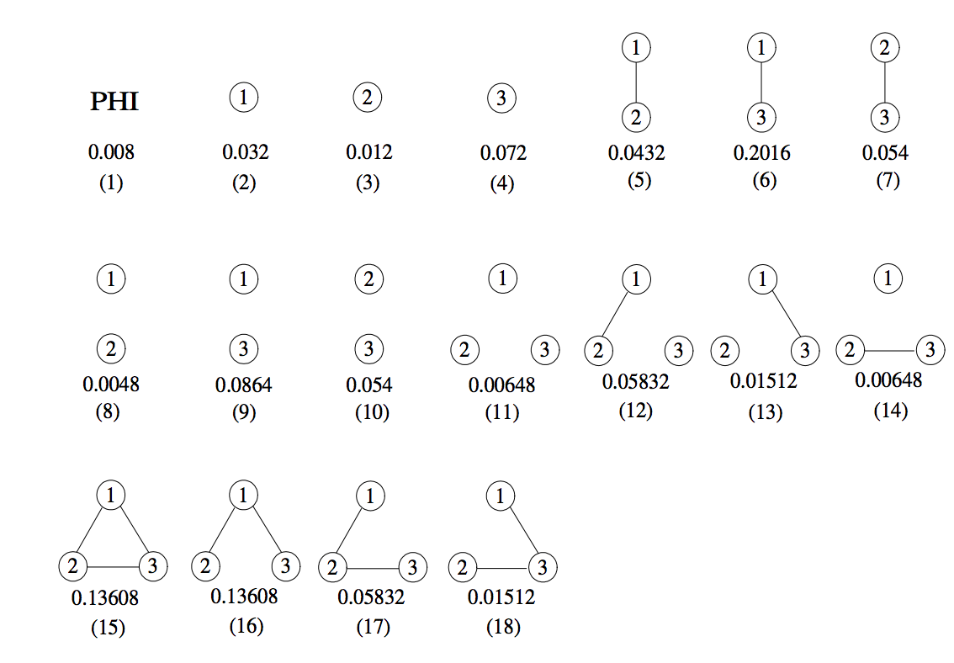
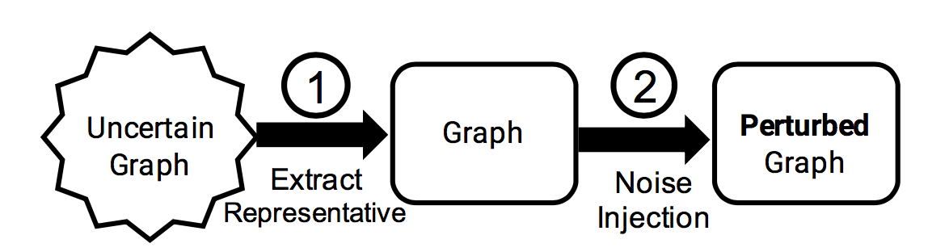

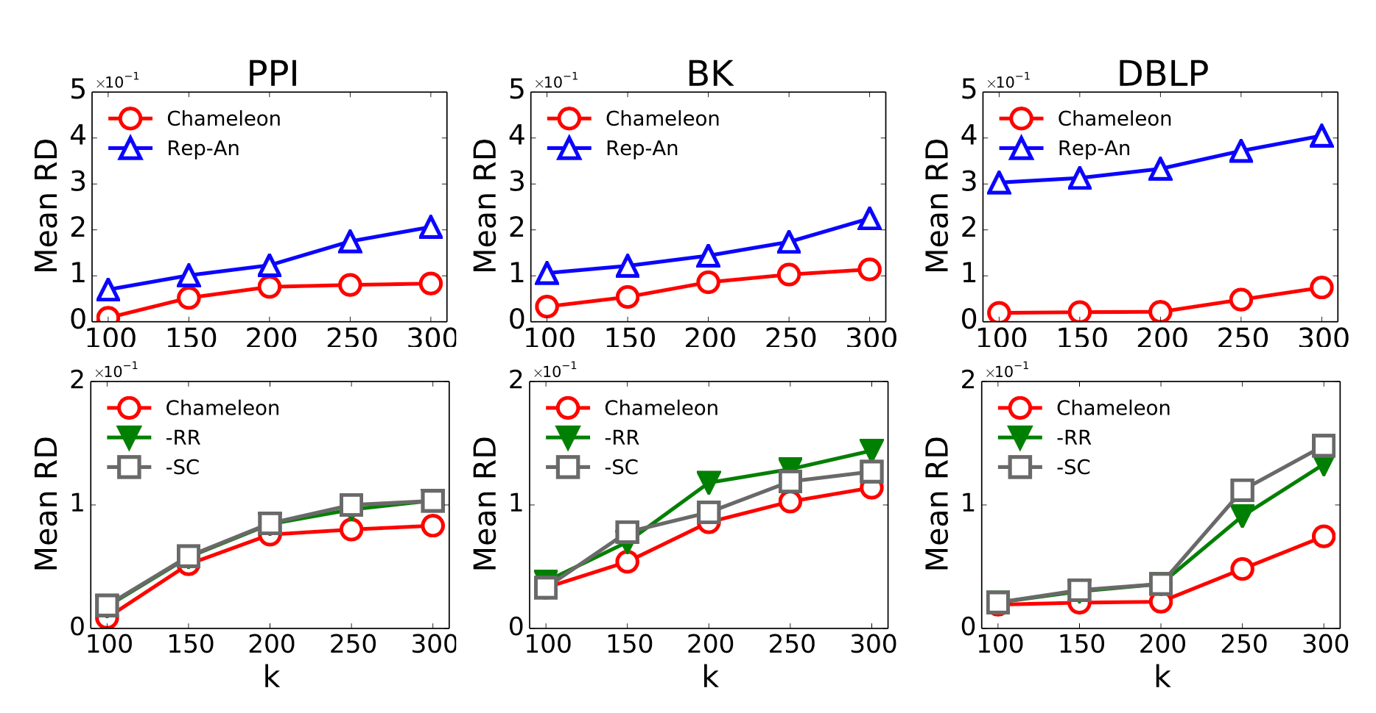
Sharing Uncertain Graphs Using Syntactic
Private Graph Model
Dongqing Xiao, Mohamed Eltabakh, Xiangnan Kong
Worcester Polytechnic Institute, USA
dxiao, meltabakh,xkong@wpi.edu
Intension: Sharing Uncertain Graphs
Challenges
Stochastic Privacy Attack
Stochastic Utility Loss
Intractable Search Space
Leak caused by edge uncertainty
Structural difference over uncertain graphs
Exponential
search space
Data
Uncertain Graph Anonymization Solutions
Intension: Privacy Concerns
Benchmark: Rep-An
Combines isolated techniques
Suffers from huge utility loss
With the possible world semantics
Enables a fine- grained control of injected noise
Data
max
1.
Heuristic Evaluation
Utility Relevance (RR)
Guided Random Search
2.
Random
Sampling
Privacy Vulnerability (SC)
Option: Anonymization
mid
min
3.
Selection
(k-anonymity variant)
Binary search
the minimal amount of necessary noise
Uncertain Graph
Empirical Evaluation
Weighted Graph
The generated anonymized uncertain graphs
that closely match the original ones w.r.t probabilistic connectivity.
@ possible world semantic
The simplest case: edge independent
Current graph anonymization works only target on deterministic graphs and overlook the uncertain scenario.
Reference
Parchas, Gullo, Papadias, and Bonchi. The pursuit of a good possible world: extracting representative instances of uncertain graphs. SIGMOD, 2014.
P. Boldi, F. Bonchi, A. Gionis, and T. Tassa. Injecting uncertainty in graphs for identity obfuscation. VLDB, 2012.
W.-Y. Day, N. Li, and M. Lyu. Publishing graph degree distribution with node differential privacy. SIGMOD, 2016.

